Slide 1
CLOUD-1
AWS
Wethinkcode_
2019
ANTINI
TNTINI

Slide 2
Install a simple wordpress website on a cloud infrastructure (AMAZON WEB SERVICES)
• Your website must be running at all times on at least 2 servers, if possible located in different server farms.
• Some sort of mechanism will randomly and evenly redirect visitors to any of your servers
• Traffic pikes will trigger the launch of other servers with perfectly synced data (and the other way around if the traffic fades)
• Logged in users will stay identified for the length of a normal session, no matter what
• Static content should be distributed as best as you can (CDN)
• New content on the site should be available across all instances immediately (or at least within a few seconds)
• Any failure should be handled so that your website is always available
• Hosting cost should reflect your actual usage
• The public should not even be able to reach anything they have no reason to reach.

Slide 3

1. Intro
Architecture for Web App.
EC2 Instances Using Linux EC2 (AWS Free Tier).
RDS database (AWS Free Tier). Mysql that is scalable.
Elasticbeanstalk Deploy install wordpress. Config the database, Load Balance, scalability
Security / Group

Slide 4
Amazon RDS for MySQL frees you up to focus on application development by managing time-consuming database administration tasks including backups, software patching, monitoring, scaling and replication.
Amazon RDS supports MySQL Community Edition versions 5.5, 5.6, 5.7, and 8.0 which means that the code, applications, and tools you already use today can be used with Amazon RDS.

Slide 5
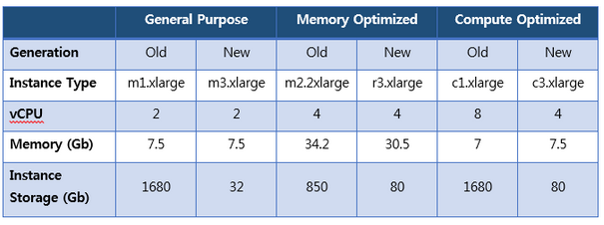
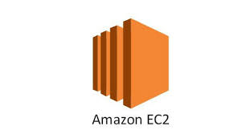
Virtual computing environments, known as instances
Preconfigured templates for your instances, known as Amazon Machine Images (AMIs), that package the bits you need for your server (including the operating system and additional software)
Various configurations of CPU, memory, storage, and networking capacity for your instances, known as instance types
Secure login information for your instances using key pairs (AWS stores the public key, and you store the private key in a secure place)
Storage volumes for temporary data that's deleted when you stop or terminate your instance, known as instance store volumes
Persistent storage volumes for your data using Amazon Elastic Block Store (Amazon EBS), known as Amazon EBS volumes
Multiple physical locations for your resources, such as instances and Amazon EBS volumes, known as Regions and Availability Zones
A firewall that enables you to specify the protocols, ports, and source IP ranges that can reach your instances using security groups
Static IPv4 addresses for dynamic cloud computing, known as Elastic IP addresses
Metadata, known as tags, that you can create and assign to your Amazon EC2 resources
Virtual networks you can create that are logically isolated from the rest of the AWS cloud, and that you can optionally connect to your own network, known as virtual private clouds (VPCs)

Slide 6
Load balancer – An Elastic Load Balancing load balancer configured to distribute requests to the instances running your application. A load balancer also eliminates the need to expose your instances directly to the internet.
Auto Scaling group – An Auto Scaling group configured to replace an instance if it is terminated or becomes unavailable.
Instance security group – An Amazon EC2 security group configured to allow inbound traffic on port 80. This resource lets HTTP traffic from the load balancer reach the EC2 instance running your web app. By default, traffic isn't allowed on other ports.
Load balancer security group – An Amazon EC2 security group configured to allow inbound traffic on port 80. This resource lets HTTP traffic from the internet reach the load balancer. By default, traffic isn't allowed on other ports.

Slide 7

WordPress.com is the easiest way to create a free website or blog. It’s a powerful hosting platform that grows with you. We offer expert support for your WordPress site.

Slide 8
AWS Elastic Beanstalk is an easy-to-use service for deploying and scaling web applications and services developed with Java, .NET, PHP, Node.js, Python, Ruby, Go, and Docker on familiar servers such as Apache, Nginx, Passenger, and IIS.
You can simply upload your code and Elastic Beanstalk automatically handles the deployment, from capacity provisioning, load balancing, auto-scaling to application health monitoring. At the same time, you retain full control over the AWS resources powering your application and can access the underlying resources at any time.

Slide 9
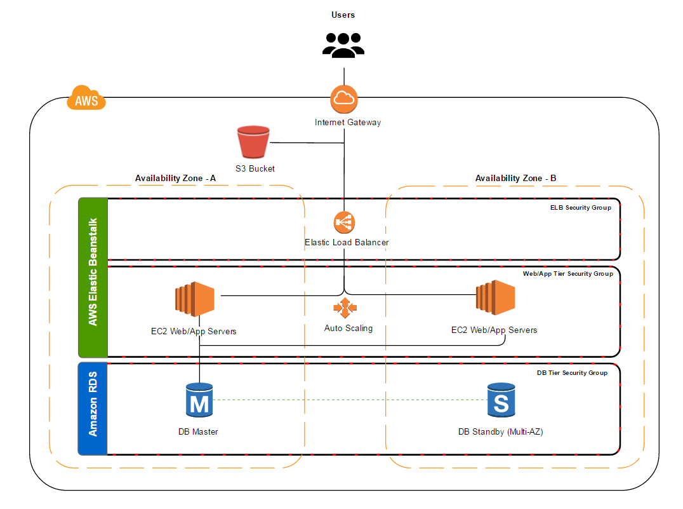

Slide 10

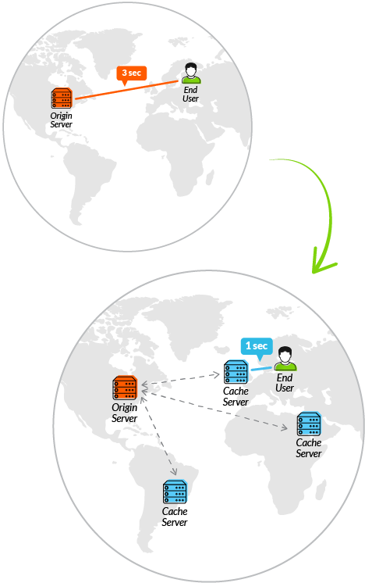
To minimize the distance between the visitors and your website’s server, a CDN stores a cached version of its content in multiple geographical locations (a.k.a., points of presence, or PoPs). Each PoP contains a number of caching servers responsible for content delivery to visitors within its proximity.
http://test-ntini.us-east-1.elasticbeanstalk.com/
ANTINI
TNTINI

